Slide 1




Slide 2





Contents:
Definition
Scope of traffic engineering
Traffic characteristics
Functions of traffic engineer
Elements of traffic engineer
Road user characteristics

Slide 3


Traffic Engineering :
It is that branch of engineering which deals with planning and geometric design of roads and highway and with traffic operation as their use is related to safe, convenient and economic transportation of person and goods.
Scope of Traffic Engineering :
Traffic characteristics
Traffic studies and analysis
Traffic operation – control and regulation
Planning and analysis
Geometric design
Administration and management

Slide 4

Traffic characteristics
The study of traffic characteristics is the most essential prerequisite for any improvement of traffic facilities. The traffic characteristics includes road users characteristics and vehicular characteristics.
The physical, mental and emotional characteristics of human beings are to be given particular attention.
The vehicular characteristics includes study of various parameters of vehicles like dimensions, weight, maximum turning radius, speed, braking system, lighting system, tyres, etc.

Slide 5

Functions of Traffic Engineer :
Collection, analysis and interpretation of traffic data
Various surveys are carried out for the collection of data :
volume study
Origin and destination study
Speed study
Parking study etc.
Traffic and transportation planning
Based on the study related to land use and transportation, mathematical
models are formulated to predict how system will behave under given condition.
Traffic design :
Geometric design of highway
Intersection design
Grade separated interchange
Design of on street and off street parking

Slide 6

4. Measures for operation of traffic :
Legislation and enforcement measures
Measures for regulation of parking of vehicle
Management measures
Traffic control devices
5. Administration
Various programmes intended to secure safe and efficient traffic in cities is also an important function of traffic engineer.

Slide 7

Elements of traffic operations
The road users - drivers and pedestrians
The vehicles
The highway
The environment

Slide 8

The behaviour of traffic is highly dependent on the interaction amongst these four elements.
Road users : response to various stimuli varies over a wide range. The drivers have varying degree of fatigue, attention, experience, training etc.
Vehicle : they differ in dimension, weight and performance characteristics. Highway : It have varying grades, alignment, carriage way width and surface. Environment condition : weather, adjacent landuse

Slide 9

ROAD USER CHARACTERISTICS
Road user behavior is affected by both external and internal factors.
The internal factors can be classified as following.
Physical factors
Temporary factors
Permanent factors
Psychological factors
The environment factors are consider as external factors.

Slide 10

ROAD USER FACTORS
Physical factor
Psychological factor
Environment factor

Slide 11

PHYSICAL FACTOR
Permanent
Vision Hearing Strength
Judgement power
Reaction power
Temporary
Fatigue Alcohol, drug
Illness, disability Anger
Climate, season, time.

Slide 12

PERMANENT PHYSICAL FACTOR
⚫
Visual activities of road users:
Vision is one of the important factors that affects almost all aspects of highway design & safety. The human eye is the sensory organ that enables one to see and evaluate the size, shape & colour of objects & estimate distances and speed of bodies.

Slide 13
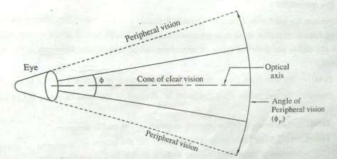
The various aspects of human vision which affects the road user are:
1. Visual acuity (eye sight):

Slide 14

Peripheral vision :
It deals with total visual field for the two eye.
Angle of peripheral vision , horizontal direction = 160 ˚ vertical direction = 115 ˚
Eye movement
Colour vision :
Under a good light many colours may differentiate but as light decreases , some colours are less visible.
Colour blindness is a condition where one cannot distinguish between different colour.

Slide 15

Glare vision and recovery :
Adaptability to light is an important factor of vision. Eye takes more time to adapt when we go from light to dark.
Glare recovery time is the time required to recover from the effect of glare after the light source is passed.
Perception of time and space :
Perception of space refer to ability of eyes to judge the space depth and
time.

Slide 16

Hearing: Hearing is an aid to the road-user which can at times be very vital. The sound of a horn or the sound of the nearing vehicle itself can alert a pedestrian to safety.
Strength: though strength is not an important factor in general, lack of strength may
make parking manoeuvres difficult, particularly for heavy vehicles.
Reaction time: the time required to perceive & understand the traffic situation & to take the appropriate action is known as reaction time.
Judgement power: Ability to judge the coming situation depends upon experience & one’s own judgement power. before the actual response it is the right judgement of the steps to be taken to avoid the mishaps.

Slide 17

PSYCHOLOGICAL FACTORS
Motivation
Intelligence
Learning
Emotion
Individual difference
PIEV time

Slide 18

Motivation: people enter the traffic stream for business, social, recreation, marketing purposes. they may be intent on going to a regular place of employment, to market, to rail, water, air or other terminals.
Intelligence: the capacity of the road user to be aware of external factors pertinent to his behavior in traffic and to adapt and adjust himself in accord with his intents and motives required a fair degree of intelligence.
learning: the learning process, while dependent on motivation, intelligence, and other modifying factors, develops the skills, habits and abilities of road users to respond properly to the total environment of traffic operations.
Emotion: usually emotion strongly motivates the road user to inefficient, random adjustment. fear anger, worry, and other similar emotional states tend to create disorganized reaction and behavior.
Individual difference: because of the modifying factors of motivation, intelligence, learning and emotion there is a great variation among users of the highway.

Slide 19

ENVIRONMENT FACTORS
Traffic stream characteristics
Facilities to the traffic
Atmospheric conditions
Locality, land use & activities

Slide 20

PIEV theory
According to theory, the total reaction time of the driver is split into 4 parts
Perception time
Intellection time
Emotion time
Volition time

Slide 21

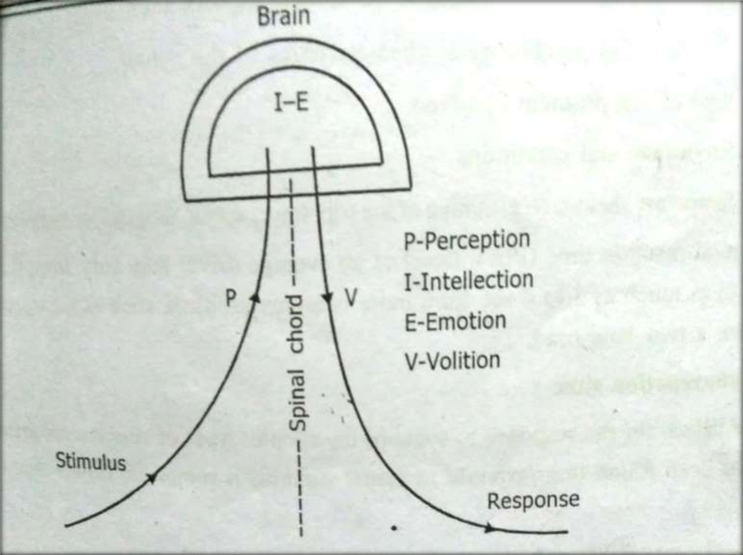

Slide 22

Perception time: Perception time is the time required for the sensations received by the eyes or ears to be transmitted to the brain through the nervous system and spinal chord.
Intellection time: It is the time required for understanding the situation. it is also the time required for comparing the different thoughts, regrouping and registering new sensations.
Emotion time: it is the time elapsed during emotional sensations and
disturbance such as fear, anger, etc. with reference to the situation.
Volition time: volition time is the time taken for the final action. the “will” to take some act or produce some action is volition.

Slide 23

The PIEV time of a driver depends on several factors such as:
Physical & psychological characteristics of the driver.
Type of the problem involved.
Environmental conditions.
Temporary factors.
The total reaction time (PIEV time) of an average driver may vary from 0.5 sec for simple situation to as much as 3 to 4 sec for a more complex problem, such as the decision to overtake and pass on a two-lane road.

Slide 24

SIMPLE REACTION TIME
Time value for the response to the some of the simpler types of stimulus are known as reaction time. It has been found that response to visual stimulus is somewhat slower than auditory or touch stimuli.
Typical comparable values are given below.
Reaction time for various stimuli:
Stimulus | Reaction time (sec)
Light | 0.18
Sound | 0.14
Touch | 0.18

Slide 25
THANK YOU

